Slide 1

Organizational Communication VS interpersonal communication

Slide 2


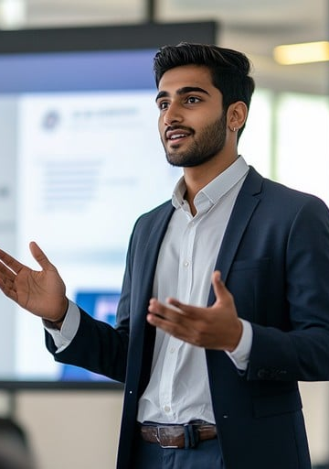

Organizational Communication
Organizational communication is how information and messages are shared to help people work together. It has two types: Formal communication: Official,professional Informal communication: Casual, natural conversations between people.

Slide 3
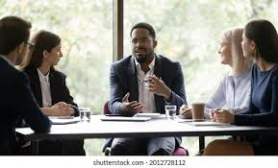
An Instructor Speaking to a Group of Employees
Facial expressions: Speaker confident; listeners interested.
Eyes: Everyone looking at the speaker → strong attention.
Head: Speaker upright; listeners turned toward him.
Arms: Speaker using open gestures; listeners relaxed.
Posture & seating: Formal meeting, speaker centered → leadership
3

Slide 4

Facial expressions: Smiling, relaxed → friendly interaction.
Eyes: People looking at each other → casual engagement.
Head: Slight head tilts → comfort and interest.
Arms: Open, relaxed gestures → informal atmosphere.
Posture & seating: Casual seating in a break area → non-work, social communication.
Team members discussing ideas over lunch.
4

Slide 5
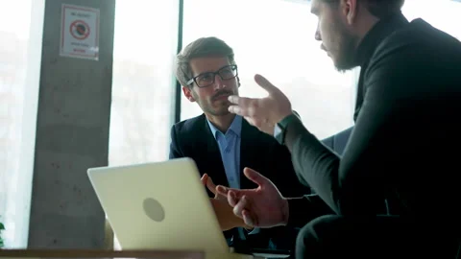
Two team leaders discussing a project
Facial expressions: Serious, focused.
Eyes: Listener maintains eye contact → professional attention.
Head: Listener slightly tilted → evaluating.
Arms: Speaker uses clear gestures → formal explanation.
Posture: Formal seating with laptop → workplace meeting.
5

Slide 6

Facial expressions: Two people whispering → secretive and informal.
Eyes: Focused on each other → private exchange.
Head: Leaning close together → confidentiality.
Arms: One hand covering
mouth → discretion.
Posture & seating: Close, casual seating → non-official talk.
rumor exchange
6

Slide 7

Job Interview
Facial expressions:
Neutral, attentive → focused and professional.
Eyes: Mutual eye contact → active listening and evaluation.
Head: Slight forward tilt → interest and engagement.
Arms: Clasped hands and note-taking → formality and attentiveness.
Posture & seating: Opposite sides of table → structured interview setup.
7

Slide 8


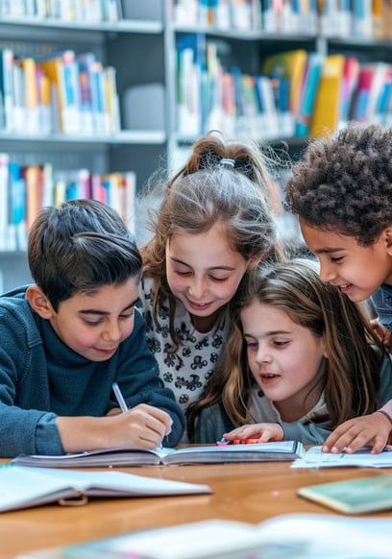
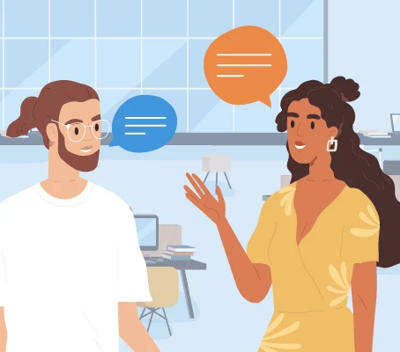
Interpersonal Communication
Interpersonal communication is the process of exchanging information, feelings, and meanings between two or more people through verbal and nonverbal messages. It helps build relationships, share ideas, and understand others effectively in both personal and professional settings.

Slide 9

Friends Engaging in a Casual Conversation at a Coffee Shop
Facial expressions: All participants smiling and laughing ,positive emotions and openness. Eyes: Eye contact among friends ,attentiveness and mutual interest. Head: Slightly tilted toward each other, active engagement. Arms: Relaxed gestures, some holding cups ,comfort and informality. Posture & seating: Leaning slightly forward in a relaxed setting ,friendly interpersonal connection.
9

Slide 10

Facial expressions: Comforting friend showing concern and empathy; the other looking down with sadness ,emotional depth.
Eyes: Comforter’s gaze focused on her friend, shows emotional support.
Head: Comforter’s head slightly tilted in empathy, caring gesture.
Arms: One hand gently placed on the other’s neck, reassurance and compassion.
Posture & seating: Sitting close together,intimacy
Friend Comforting Another After Receiving Bad News
10

Slide 11
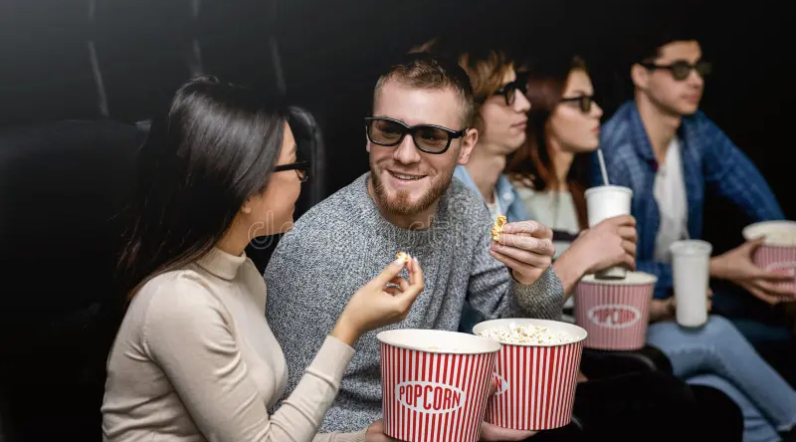
Friends Talking at the Cinema
Facial expressions: Both smiling and looking at each other , friendly and engaged interaction. Eyes: Focused on each other despite the movie environment ,shows attention and connection. Head: Slightly leaned toward one another ,interest and closeness. Arms: Relaxed, holding popcorn ,casual body language. Posture & seating: Sitting side by side in a relaxed setting, informal, friendly interpersonal communication.
11

Slide 12

Facial expressions: All smiling and laughing ,joy and openness in interaction. Eyes: Focused on each other ,active listening and connection. Head: Tilted slightly toward one another ,engagement and interest. Arms: Animated gestures and open hands, expressive, friendly communication. Posture & seating: Relaxed and comfortable on a couch ,informal setting reflecting close interpersonal bonds.
Friends Sharing Laughter During a Casual Conversation at Home
12

Slide 13
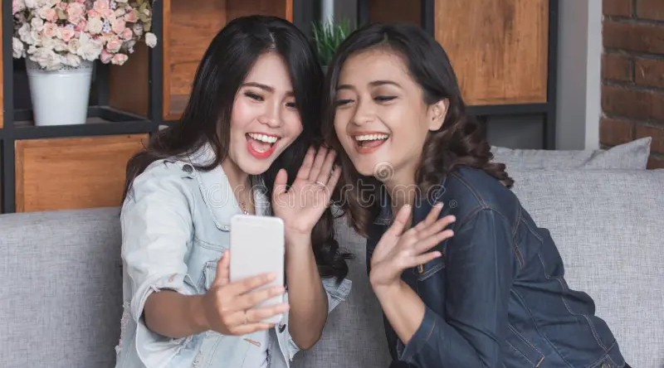
Two Friends Video Calling Their Friend in Another Country
Facial expressions: Both smiling and excited ,joy and affection in reconnecting. Eyes: Focused on the phone screen ,full attention on their distant friend. Head: Leaning slightly toward the phone ,active engagement and interest. Arms: One holding the phone, the other waving ,expressive and welcoming gestures. Posture & seating: Sitting close together on a couch ,relaxed and warm atmosphere showing interpersonal connection across distance.
13

